Slide 1
Chapter-9
Multiplication and Division Instructions
Overview
In Chapter 7, left and right shifts can be used for multiplying and dividing by powers of 2. In this chapter, we introduce instructions for multiplying and dividing any numbers.
The process of multiplication and division is different for signed and unsigned numbers, so there are different instructions for signed and unsigned multiplication and division.
9.1 MUL and IMUL (Signed Versus Unsigned Multiplication)
Because signed and unsigned multiplication lead to different results, there are two multiplication instructions:
MUL (multiply) for unsigned multiplication.
IMUL (integer multiply) for signed multiplication.

Slide 2
These instructions multiply bytes or words. If two bytes are multiplied, the product is a word (16 bits). If two words are multiplied, the product is a doubleword (32 bits). The syntax of these instructions is
MUL source
and
IMUL source
Byte Form
For byte multiplication, one number is contained in the source and the other is assumed to be in AL. The 16-bit product will be in AX. The source may be a byte register or memory byte, but not a constant.
Word Form
For word multiplication, one number is contained in the source and the other is assumed to be in AX. The most significant 16 bits of the doubleword product will be in DX, and the least significant 16 bits will be in AX (we sometimes write this as DX:AX). The source may be a 16-bit register or memory word, but not a constant.

Slide 3
For multiplication of positive numbers (0 in the msb), MUL and IMUL give the same result.
Effect of MUL/IMUL on the Status Flags
SF, ZF, AF, PF : Undefined.
CF/OF :
After MUL, CF/OF = 0 if the upper half of the result is zero.
= 1 otherwise
After IMUL, CF/OF = 0 if the upper half of the result is the
sign extension of the lower half (the bits of the upper half are same as the sign bit of the lower half)
= 1 otherwise

Slide 4
Examples
Example 9.1: Suppose AX contains 1 and BX contains FFFFH)
Instruction Decimal product Hex product DX AX CF/OF
MUL BX 65535 0000FFFF 0000 FFFF 0
IMUL BX -1 FFFFFFFF FFFF FFFF 0
Example 9.2: Suppose AX contains FFFFH and BX contains FFFFH)
Instruction Decimal product Hex product DX AX CF/OF
MUL BX 4294836225 FFFE0001 FFFE 0001 1
IMUL BX 1 00000001 0000 0001 0

Slide 5
9.2 Simple Applications of MUL and IMUL
Example 9.6 : Translate the high-level language assignment statement
A = 5 x A – 12 x B into assembly code.
Solution :
MOV AX, 5
IMUL A
MOV A, AX
MOV AX, 12
IMUL B
SUB A, AX
Example 9.7 : Write a procedure FACTORIAL that will compute N! for a
positive integer N.

Slide 6
Solution:
FACTORIAL PROC
MOV AX, 1
TOP:
MUL CX
LOOP TOP
RET
FACTORIAL ENDP

Slide 7
9.1 DIV and IDIV (Signed Versus Unsigned Division)
There are separate instructions for signed and unsigned division:
DIV (divide) for unsigned division.
IDIV (integer divide) for signed division.
The syntax is
DIV divisor
and
IDIV divisor
These instructions divide 8 (or 16) bits into 16 (or 32) bits. The quotient and remainder have the same size as the divisor.

Slide 8
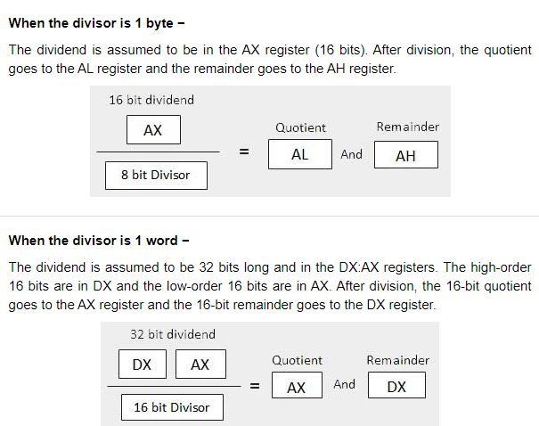

Slide 9
9.1 DIV and IDIV (Signed Versus Unsigned Division)
Byte Form
In this form, the divisor is an 8-bit register or memory byte. The 16-bit dividend is assumed to be in AX. After division, the 8-bit quotient is in AL and the 8-bit remainder is in AH. The divisor may not be a constant.
Word Form
Here the divisor is a 16-bit register or memory word. The 32-bit dividend is assumed to be in DX:AX. After division, the 16-bit quotient is in AX and the remainder is in DX. The divisor may not be a constant.
For signed division, the reminder has the same sign as the dividend. If dividend and divisor are positive, DIV and IDIV give the same result.
The effect of DIV/IDIV on the flags is that all status flags are undefined.

Slide 10
Example 9.8: Suppose DX contains 0000H, AX contains 0005H, and BX
contains 0002H.
Instruction Decimal Decimal AX DX
quotient remainder
DIV BX 2 1 0002 0001
IDIV BX 2 1 0002 0001
Example 9.9: Suppose DX contains 0000H, AX contains 0005H, and BX
contains FFFEH.
Instruction Decimal Decimal AX DX
quotient remainder
DIV BX 0 5 0000 0005
IDIV BX -2 1 FFFE 0001

Slide 11
Example 9.10: Suppose AX contains 00FBH, BL contains FFH.
Instruction Decimal Decimal AX DX
quotient remainder
DIV BL 0 251 FB 00
IDIV BL DIVIDE OVERFLOW

